Slide 1
History summer fun pack
Contents page
Explanation
Genghis Khan Demonstration
What to put in each box
Template
List of suggestions of divisive figures
List of reliable websites
Challenge

Slide 2
Create your own divisive Historical figure Bibliography.
Divisive means a person that divides opinion. These our normally the most interesting and controversial people in History.
I have created one about Genghis Khan the mighty Mogul leader on the next slide.

Slide 3
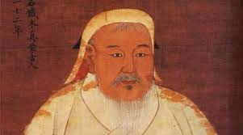
Death
Genghis Khan died in 1227 during a military campaign against the Chinese kingdom of Xi Xia. His final resting place remains unknown.
Significance
Some estimate that as many as 40 MILLION people were slaughtered in the course of Genghis Khan’s invasions.
But he also granted religious freedom to his subjects, abolished torture, encouraged trade and created the first international postal system !
Genghis Khan (1162–1227)
Warrior Emperor
Historical Debate
Summary
He rose from humble beginnings to establish the largest land empire in history!
After uniting the nomadic tribes of the Mongolian plateau, he conquered huge chunks of central Asia and China.
His descendants expanded the empire even further, advancing to such far-off places as Poland! At their peak, the Mongols controlled area about the size of Africa.
Charles J Halperin: “(Genghis) was no more cruel, and no less, than empire builders before and since.
Stacey Hodgedkin
“Ghenghis Khan was a cruel despot who raised mountains of human skulls”
VS
Fun Fact: Genghis really had a LUST for life. He has so many babies with different women each day that approximately 16 million men today share his DNA!

Slide 4
Image
Picture from the internet
Or you could draw one?
Death
How and when they died.
Significance
Important achievements that affected people for many years or even still to this day.
Anything new and unique they may have done.
These achievements can be negative as well as positive.
Name (years lived)
Title
Historical Debate
Summary
Brief summary of their life.
Where they lived?
What they are famous for ?
What some historians say about them. A quote would be good.
What other historians say about them. A quote would be good.
VS
Weird Fact
A weird/ random/ funny fact not many people would know.

Slide 5
Death
Significance
Historical Debate
Summary
VS
Fun Fact:

Slide 6
Historical figures you might consider
Vlad the Impaler
Boudicca
General Douglas Haig
Henry VIII
Augustus
King John
Bloody Mary
Oliver Cromwell
Or research one of your own

Slide 7
Websites to get you started
BBC Bite size
BBC History
History Extra
John D Clare . Net
The British Library
Or Come see me before the summer holiday I might have a text book that could be of use

Slide 8
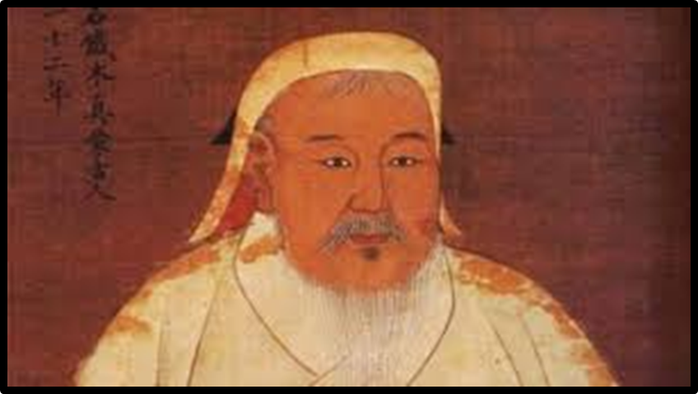
Challenge
Use your biography to create a top trump card.
Why not create a whole set.
Score them on:
how gruesome/ disgusting their death was?
Significance, how long after their death were their actions still impacting peoples lives?
Controversy, how much do they still divide opinion today?
Why not come up with a category of your own.
Category | Rating out of 10
Gruesome Death | 2
Significance | 9
Controversy | 7
One of your own

